Slide 1

Experiment 2: Number System Emulator
Navarro, Rod Geryk C.
CPE160P - 4– A1

Slide 2
OBJECTIVES
To be able to demonstrate how Arduino Kit will be used to emulate conversion between number systems.
2. To be able to apply embedded system in number system conversion using LEDs, Seven-segment display, and switches.
3. To be able to apply what you have learned in Microprocessor and Logic Circuits and Switching Theory.
4. To be able to apply embedded system in a simple handshaking using Arduino Kit.

Slide 3
MATERIALS
Arduino Kit
8 LEDs
8 220k ohm Resistors
4 10k ohm Resistors
4 Buttons
Breadboard
7-Segment Display
Arduino Uno
Laptop

Slide 4
PROCEDURE
Create a working 7-Segment Display circuit using Arduino.
Create number patterns in the Arduino IDE.
Create a working LED circuit using Arduino.
Create light patterns in the Arduino IDE.
Debug the code

Slide 5
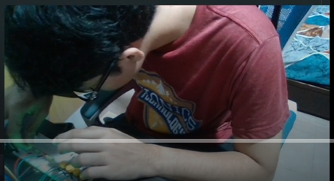
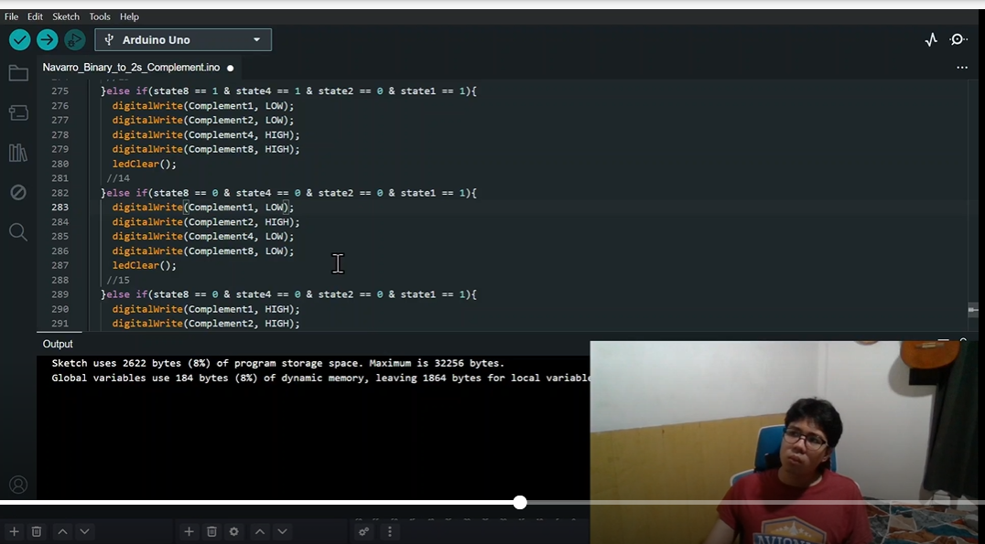
PROCEDURE

Slide 6
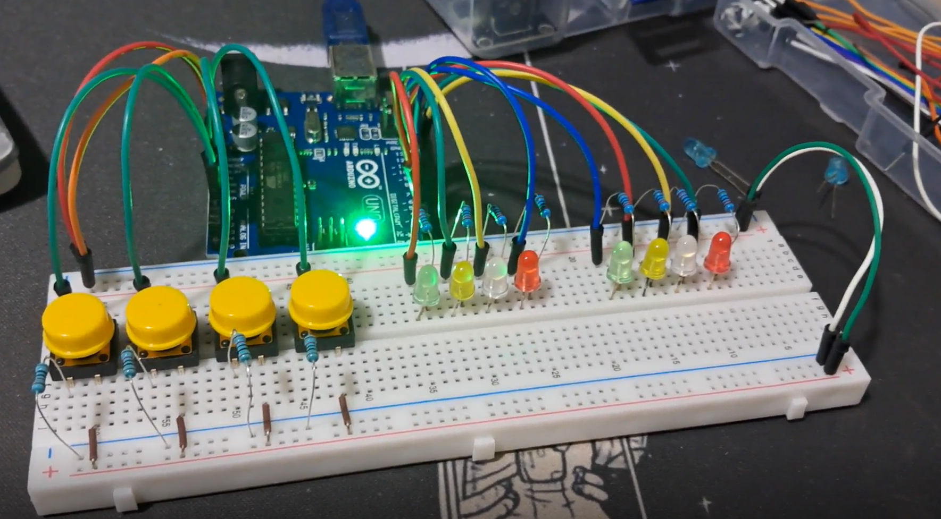
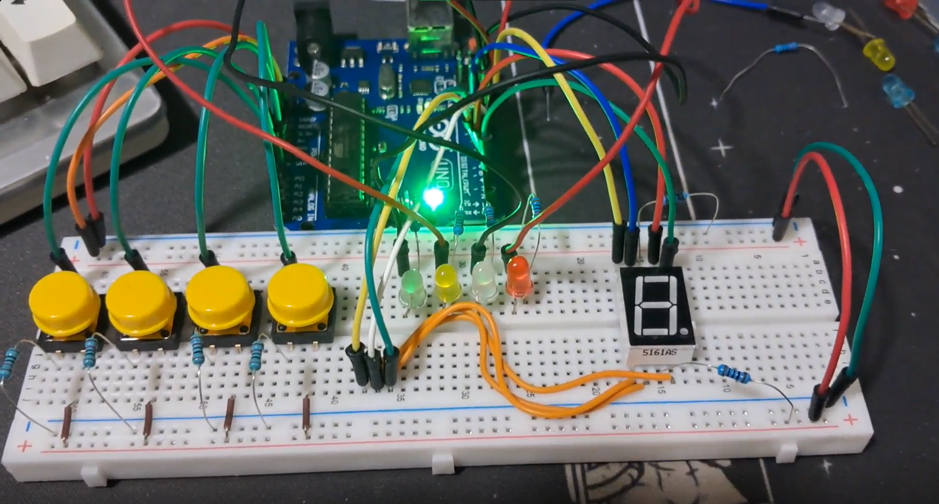
PROCEDURE

Slide 7
THANK YOU!

